Slide 1

Predicting House Prices
Ali Tahsili
April 2022

Slide 2
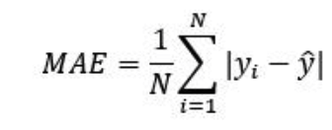
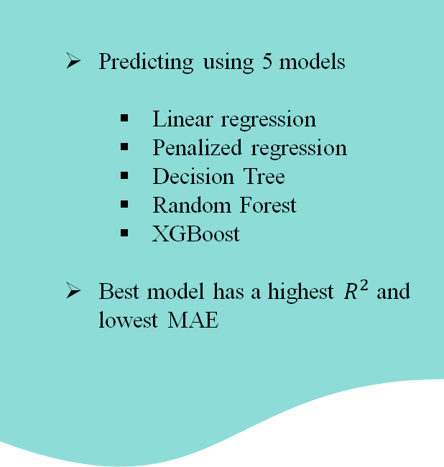
Predicting using 5 models
Linear regression
Penalized regression
Decision Tree
Random Forest
XGBoost
Best model has a highest $R^{2}$ and lowest MAE
Data
Jun 1964
Sep 2021
Feb 2022
70%
30%
Training Data
Test Data
Whole Data
Data Collection
Data Preparation and Wrangling
Data Exploration
Model Training
Result
Data Cleansing
Data Preprocessing
Exploratory Data Analysis
Feature Selection
Feature Engineering
Method Selection
Performance Evaluation
Tuning

Slide 3
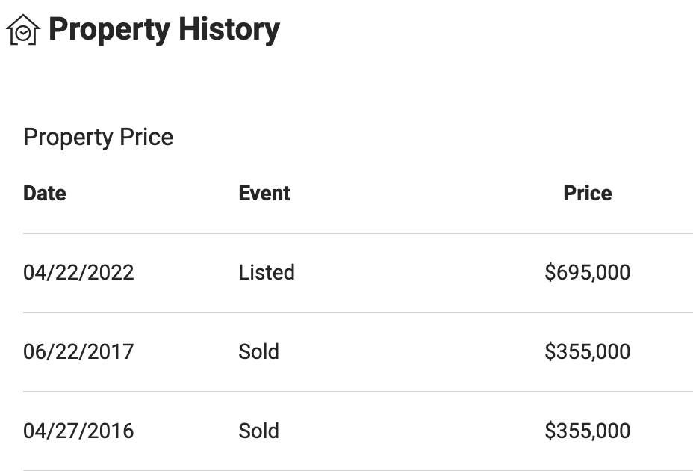
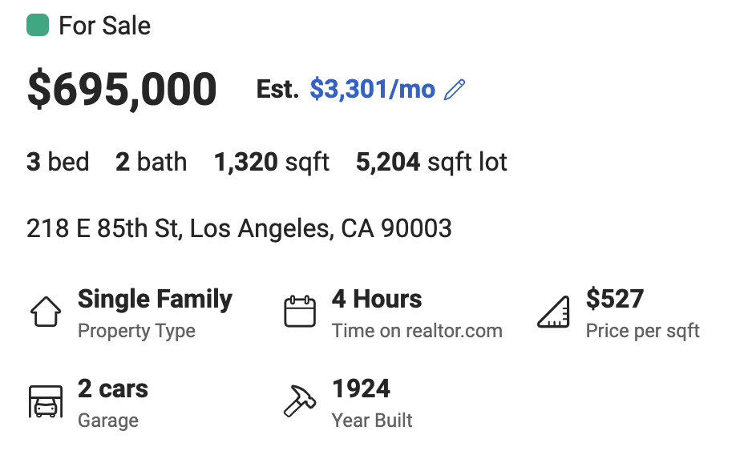

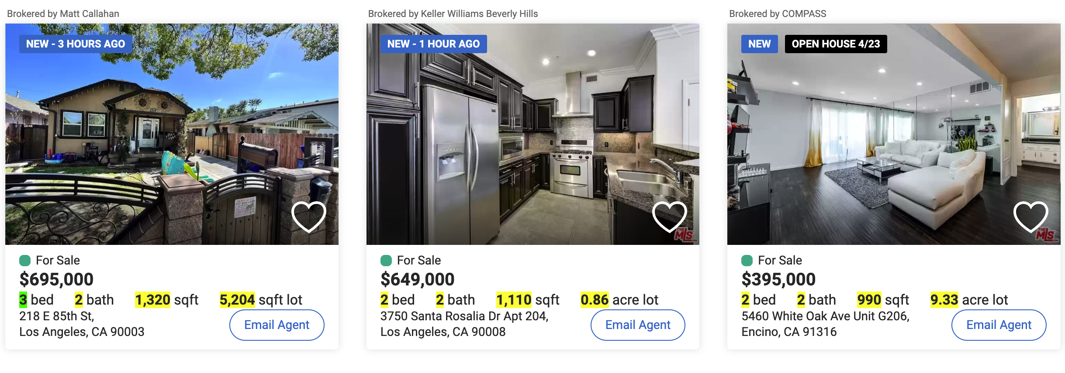

Data Collection
Data Preparation and Wrangling
Data Exploration
Model Training
Result
Data Cleansing
Data Preprocessing
Exploratory Data Analysis
Feature Selection
Feature Engineering
Method Selection
Performance Evaluation
Tuning
Scraping Data from 8652 Pages:
horse

Slide 4

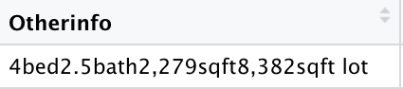
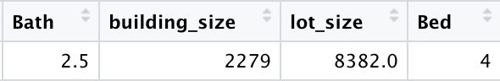

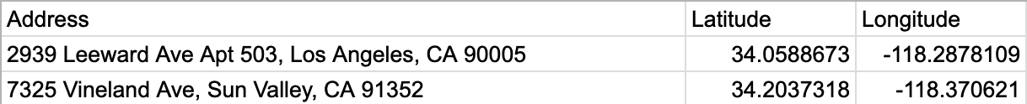
Data Collection
Data Preparation and Wrangling
Data Exploration
Model Training
Result
Data Cleansing
Data Preprocessing
Exploratory Data Analysis
Feature Selection
Feature Engineering
Method Selection
Performance Evaluation
Tuning
Predictor Variables
Using regex to convert
Price
Building Size
# of Beds
# of Bath
House Age
Property Type
Has Garage?
Sold Year
Sold Month
Longitude
Latitude
Lot Size
Age from renovation
Adjusting price based on Consumer Price Index (CPI) for each month
Removing observation with missing values: 55,600 rows to 48,500 rows
Removing extreme outliers:
48,500 rows to 40,000 rows
Left with 40,000 x 14 dataset
Target Variable
Using Google Sheets to
find latitude and longitude

Slide 5
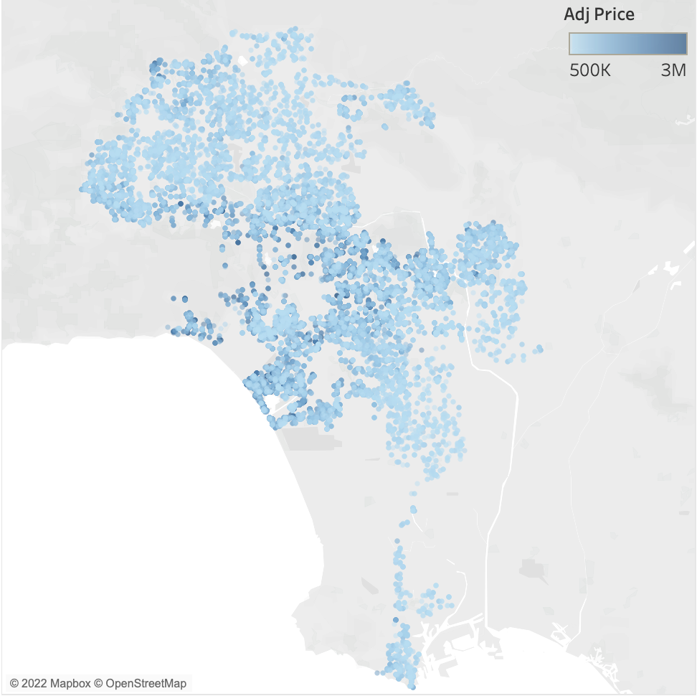
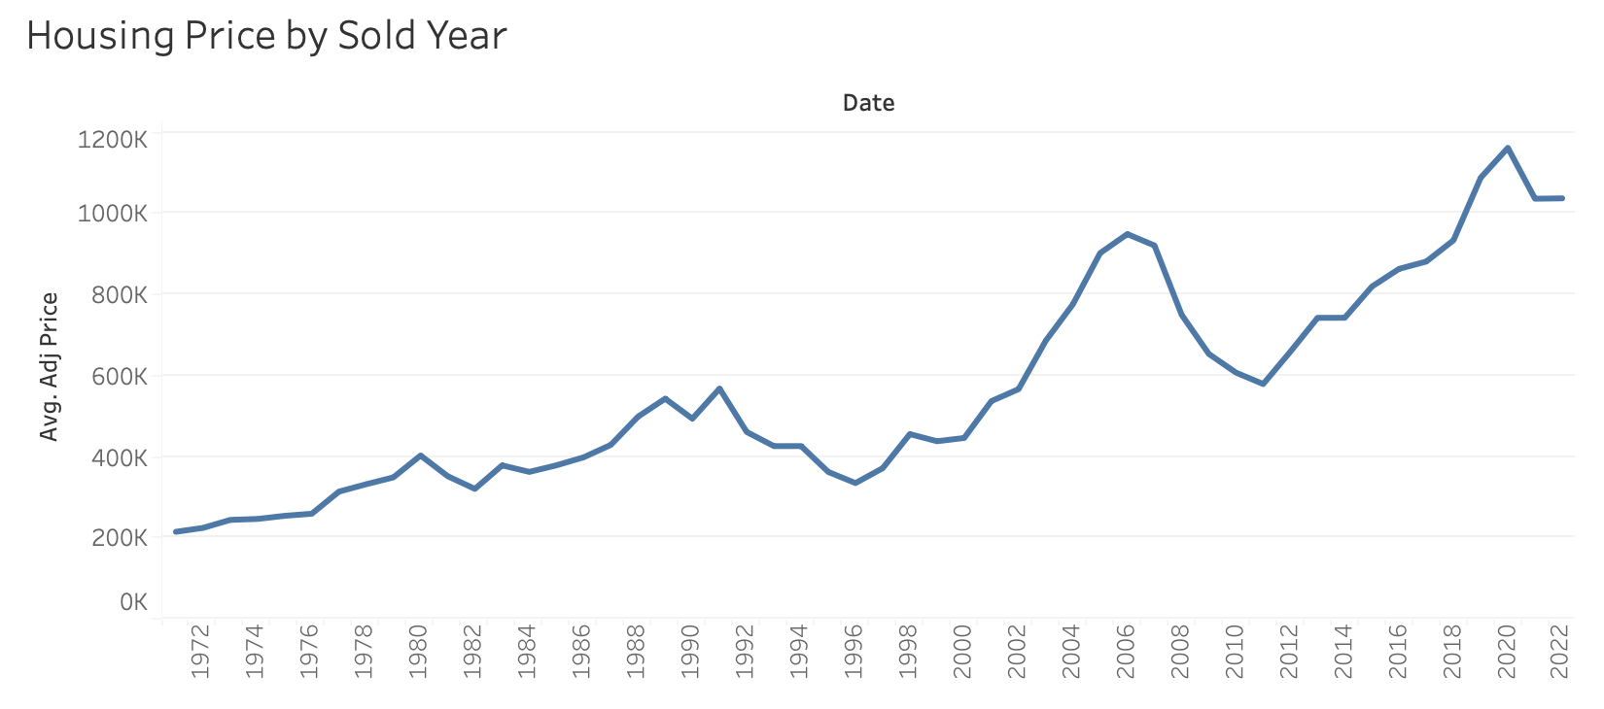
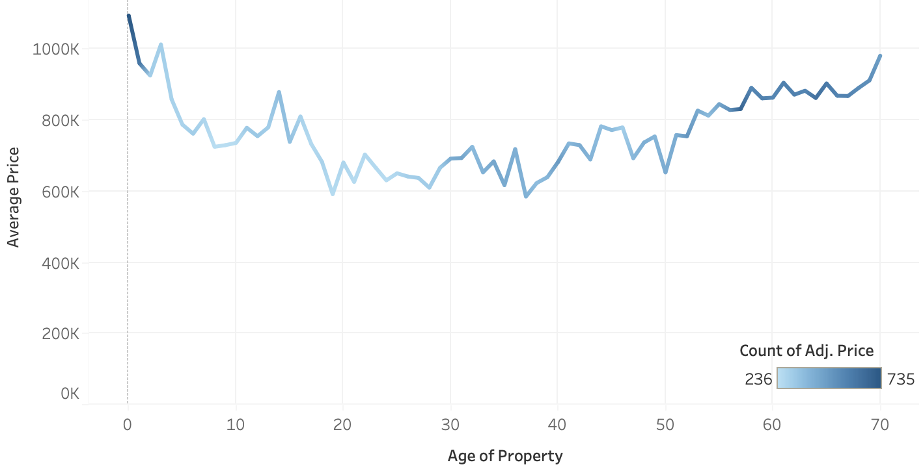
Data Collection
Data Preparation and Wrangling
Data Exploration
Model Training
Result
Data Cleansing
Data Preprocessing
Exploratory Data Analysis
Feature Selection
Feature Engineering
Method Selection
Performance Evaluation
Tuning
Houses in center and close to beach have higher prices
Adjusted prices by inflation still increases over time
Other factors, such as:
Technology
Facilities
Municipal taxes
Geographical location
Income, etc.
might affect the price other than inflation

Slide 6
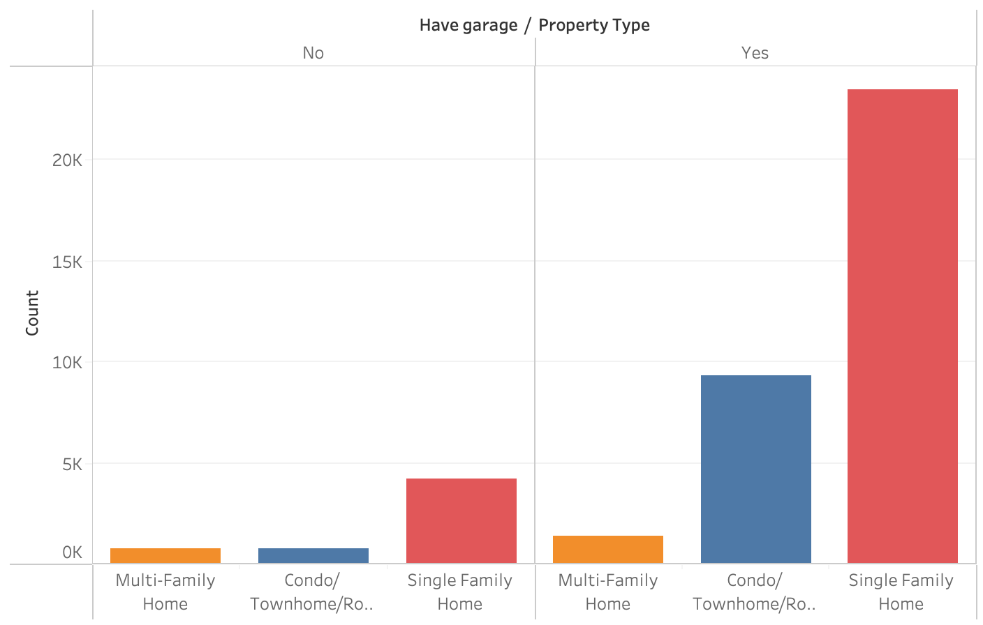
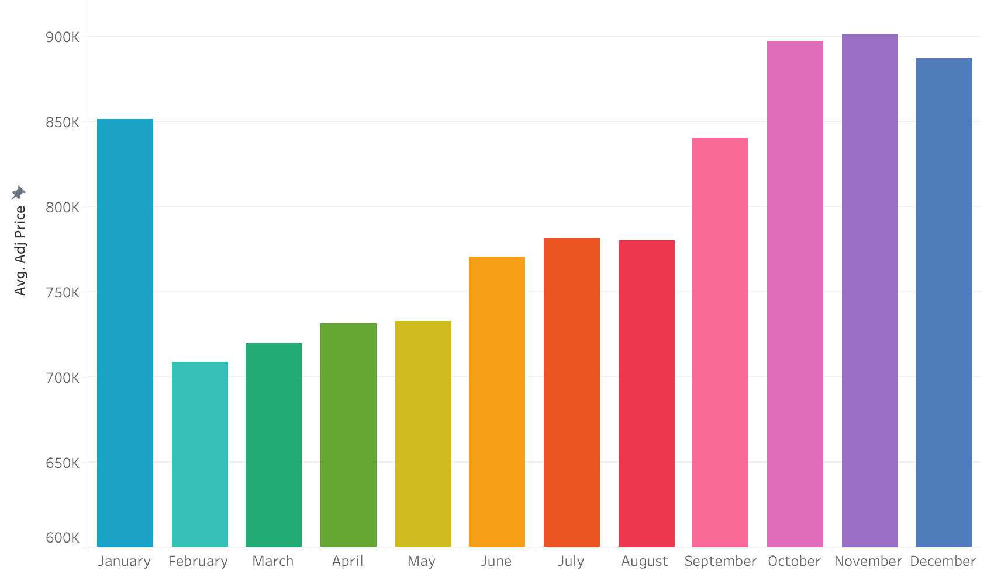
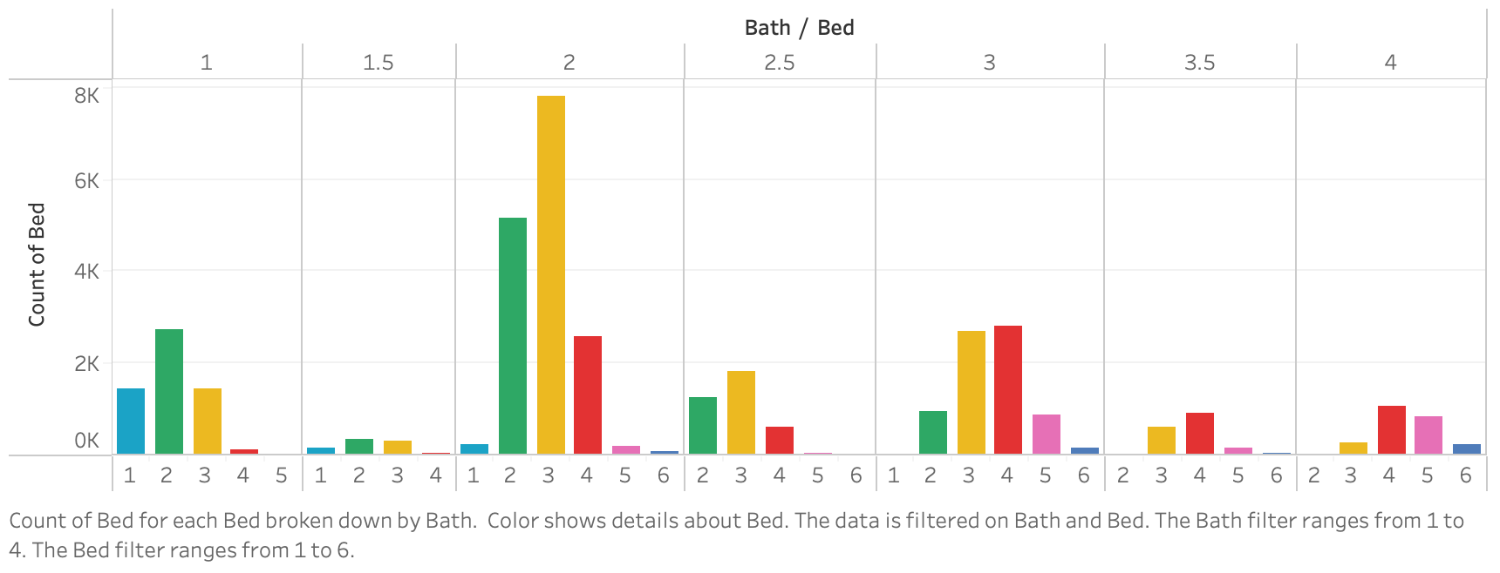
Data Collection
Data Preparation and Wrangling
Data Exploration
Model Training
Result
Data Cleansing
Data Preprocessing
Exploratory Data Analysis
Feature Selection
Feature Engineering
Method Selection
Performance Evaluation
Tuning
Notes:
Most of the observations are Single Family Homes with garages, followed by Condo/Townhome/Co-Op with garages.
In fall season real estate market faced with an increase of housing price. An off-season start from February.
3-bed and 2-bath houses are most popular in LA real estate market, indicating most houses are built for families.

Slide 7
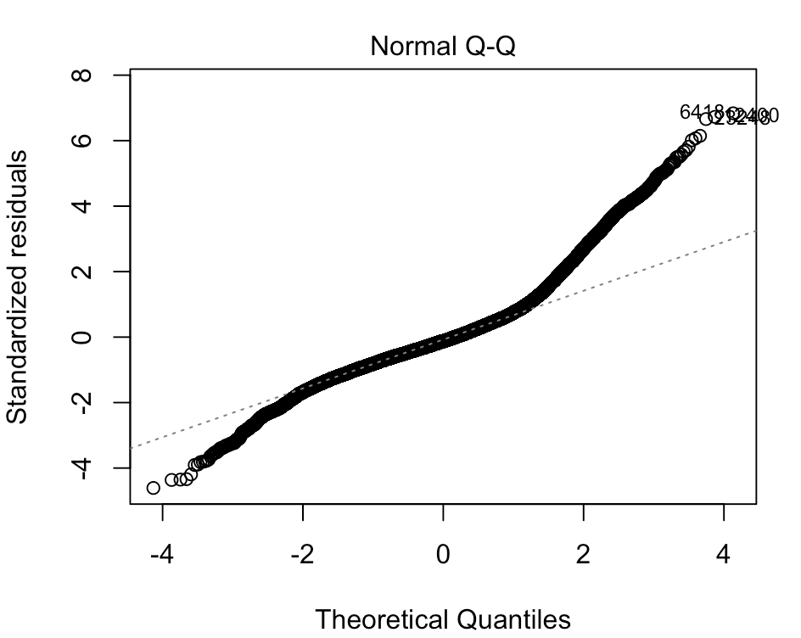
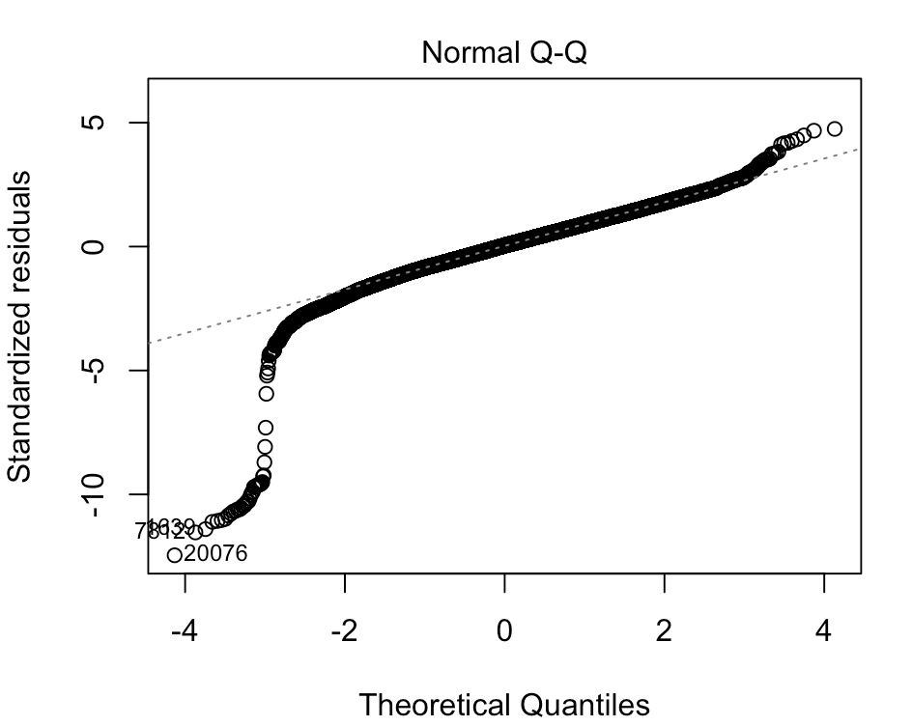
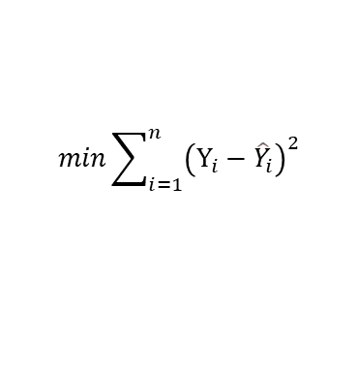
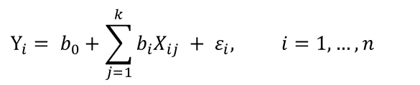
Data Collection
Data Preparation and Wrangling
Data Exploration
Model Training
Result
Data Cleansing
Data Preprocessing
Exploratory Data Analysis
Feature Selection
Feature Engineering
Method Selection
Performance Evaluation
Tuning
Multiple Linear Regression
Models the relationship between one dependent variable and multiple independent variables as a hyperplane.
Log-transformation of price:
$$Y_{i}= b_{0}+\sum_{j=1}^{k}{b_{i}X_{ij}} + ε_{i}, i=1,…, n$$
$$min\sum_{i=1}^{n}{{\left(Y_{i}−{\hat{Y}}_{i}\right)}^{2}}$$
Benefits:
Performs exceptionally well for linear data
Easier to implement, interpret and efficient to train
Drawbacks:
The assumption of linearity between dependent and independent variables
It’s often quite prone to underfitting

Slide 8
Data Collection
Data Preparation and Wrangling
Data Exploration
Model Training
Result
Data Cleansing
Data Preprocessing
Exploratory Data Analysis
Feature Selection
Feature Engineering
Method Selection
Performance Evaluation
Tuning
Benefits
Better for nonlinear data
Less effort for data preparation
Good for interpretation
Disadvantages
Instability
Overfitting
Decision tree
To find the best threshold
we need to find the minimum
sum of the squared residual
1,000,000$
Latitude > 34.2
500,000$
Building Size > 2000
800,000$
Age > 20
Threshold
1,500,000$
Notes:
A small change in the data can cause a large change in the structure of the decision tree causing instability.

Slide 9
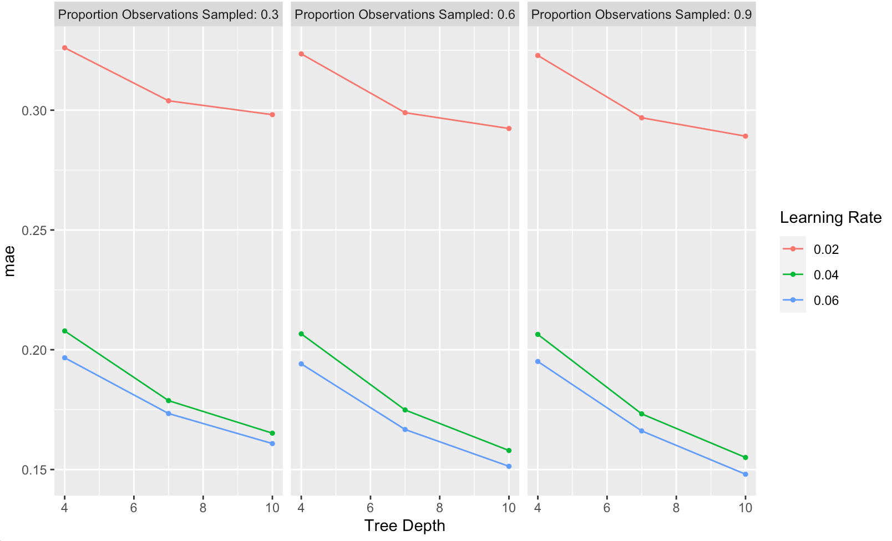
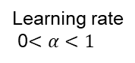
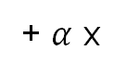
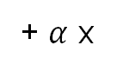
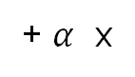
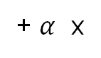
Gradient Boosting / XGBoost
Data Collection
Data Preparation and Wrangling
Data Exploration
Model Training
Result
Data Cleansing
Data Preprocessing
Exploratory Data Analysis
Feature Selection
Feature Engineering
Method Selection
Performance Evaluation
Tuning
60,000$
50,000$
Bed > 3
9,000$
Mean
Latitude > 34.2
+ $α$ x
Year Sold > 2020
+ $α$ x
-30,000$
800,000$
Building Size > 2000
-18,000$
7,000$
Longitude > -118
Learning rate 0$<α<1$
Age > 20
43,000$
-20,000$
+ $α$ x
+ $α$ x
+ …
Notes:
Weak learners will be built by putting more weight on trees with extreme errors and inaccurate predictions. The idea behind this technique is that the model learns from past mistakes.
weak learners cannot accurately predict the observations that are difficult for the model, so those will be weighted more during learning

Slide 10
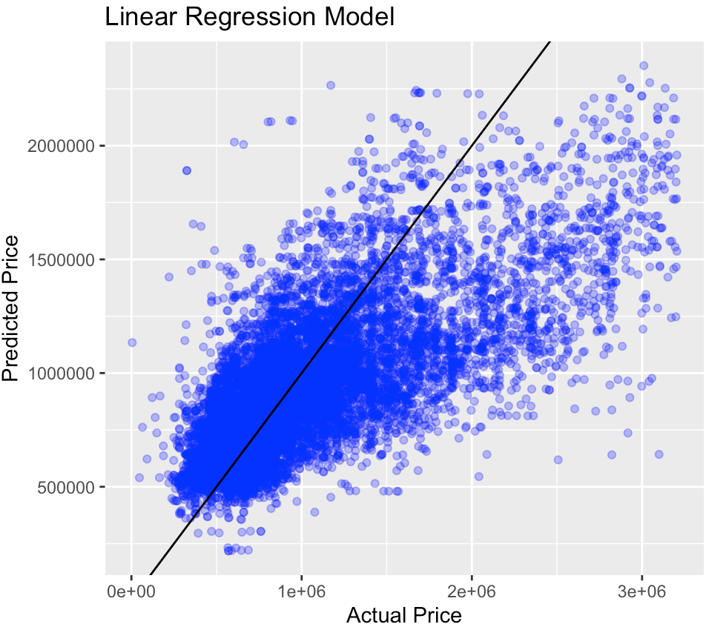
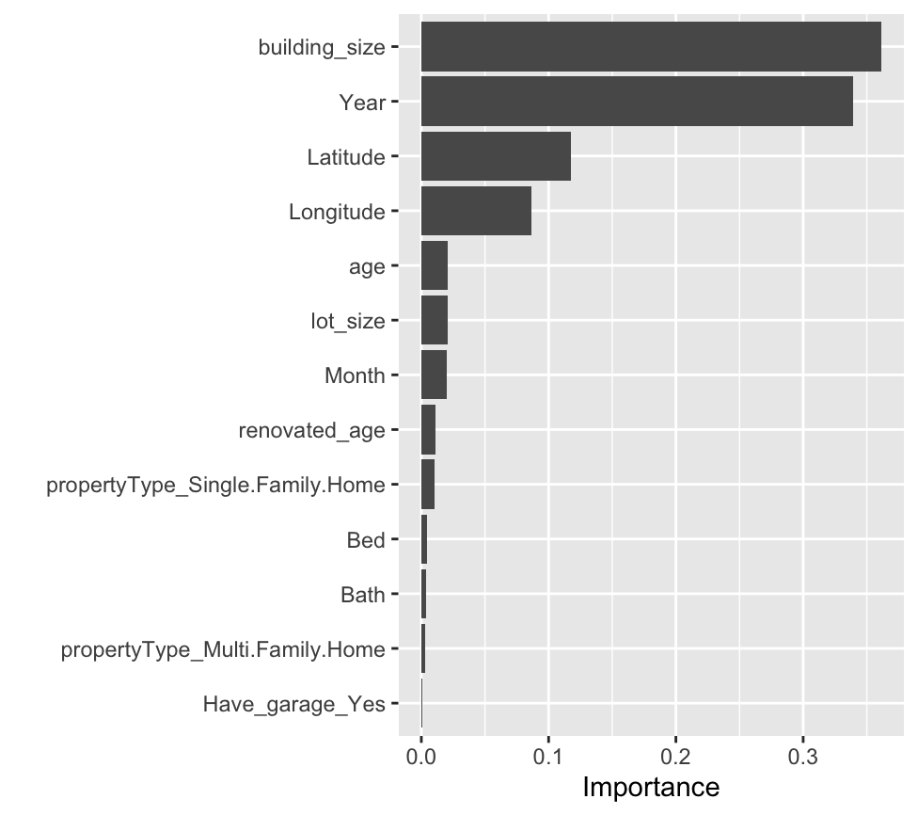
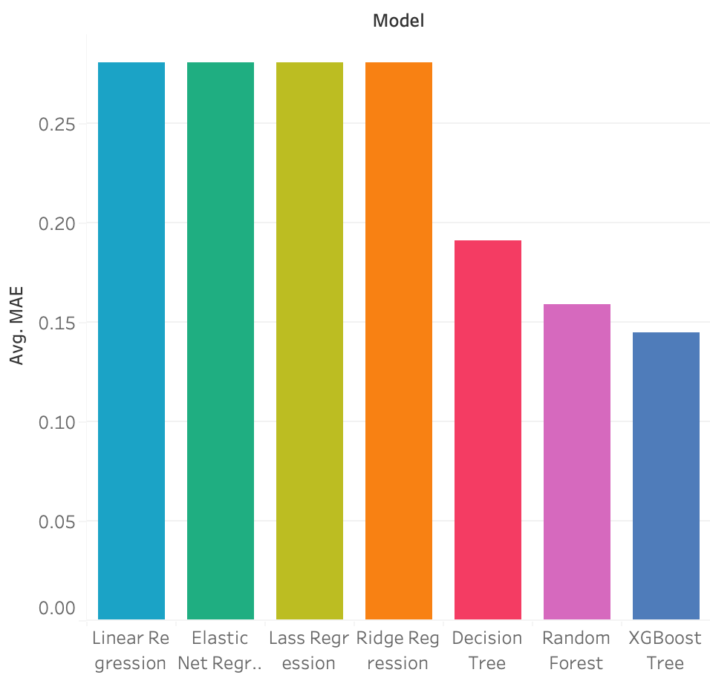
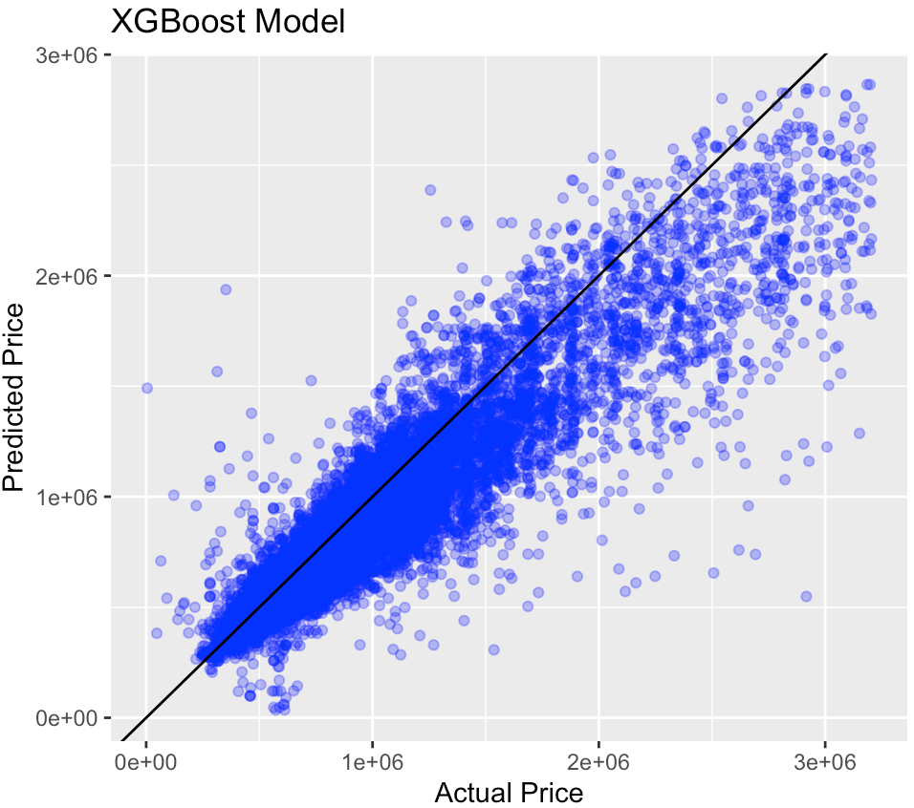
Data Collection
Data Preparation and Wrangling
Data Exploration
Model Training
Result
Data Cleansing
Data Preprocessing
Exploratory Data Analysis
Feature Selection
Feature Engineering
Method Selection
Performance Evaluation
Tuning

Slide 11
Bibliography
Anas, Alex, Arnott, and Richard J. n.d. "Technological Progress in a Model of the Housing – Land Cycle." Elsevier.
2019. CFA Program Curriculum Level I. Vols. 1-6. CFA Institute.
Hastie, Trevor, Jerome Friedman, and Robert Tibshirani. 2009. The Elements of Statistical Learning.
Kattan, Danny. n.d. Forbes. https://www.forbes.com/sites/forbesrealestatecouncil/2020/12/09/the-impact-of-technology-on-real-estate/?sh=8deaa4724341.
Mullainathan, Sendhil, and Jann Spiess. 2017. "Machine Learning: An Applied Econometric Approach." Journal of Economic Perspectives.
Zou, Hui, and Trevor Hastie. 2005. "Regularization and variable selection via the elastic net."

Slide 12
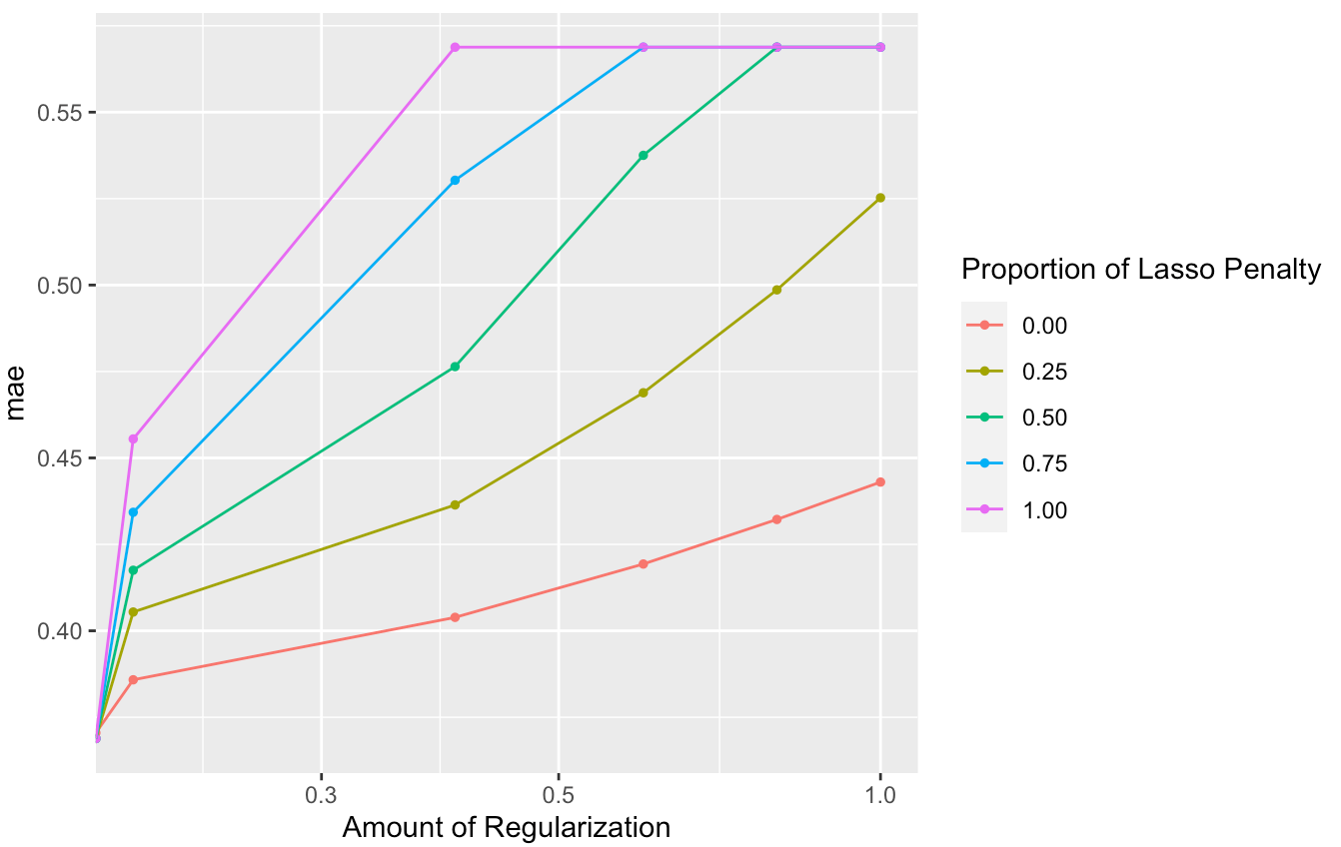
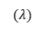
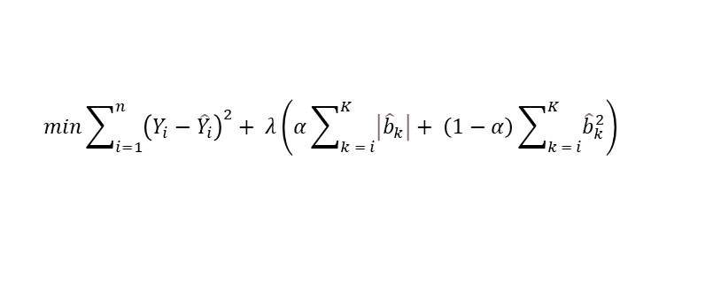
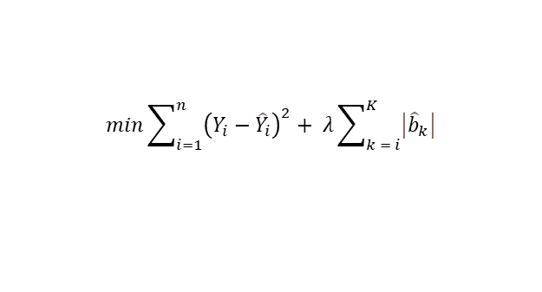
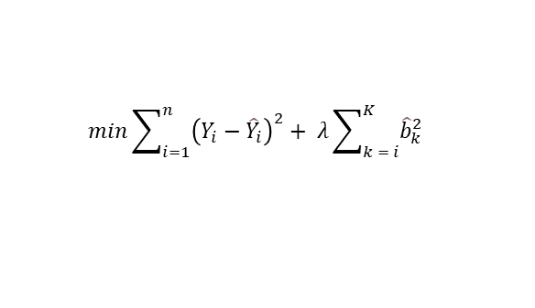

Data Collection
Data Preparation and Wrangling
Data Exploration
Model Training
Result
Data Cleansing
Data Preprocessing
Exploratory Data Analysis
Feature Selection
Feature Engineering
Method Selection
Performance Evaluation
Tuning
Ridge Regression
Fitting the training data well is not necessarily a good thing!
$$min\sum_{i=1}^{n}{{\left(Y_{i}−{\hat{Y}}_{i}\right)}^{2}}+ λ\sum_{k = i}^{K}{{\hat{b}}_{k}^{2}}$$
Using Penalized Regression to reduce several features
LASSO Regression
$$min\sum_{i=1}^{n}{{\left(Y_{i}−{\hat{Y}}_{i}\right)}^{2}}+ λ\sum_{k = i}^{K}{\left|{\hat{b}}_{k}\right|}$$
$$(α)$$
Elastic Net Regression
$$min\sum_{i=1}^{n}{{\left(Y_{i}−{\hat{Y}}_{i}\right)}^{2}}+ λ\left(α\sum_{k = i}^{K}{\left|{\hat{b}}_{k}\right|}+ \left(1−α\right)\sum_{k = i}^{K}{{\hat{b}}_{k}^{2}}\right)$$
$$(λ)$$
LASSO -> Makes coefficient to exactly zero, better interpretation
Ridge -> coefficient tends to zero, less interpretability, superior prediction

Slide 13
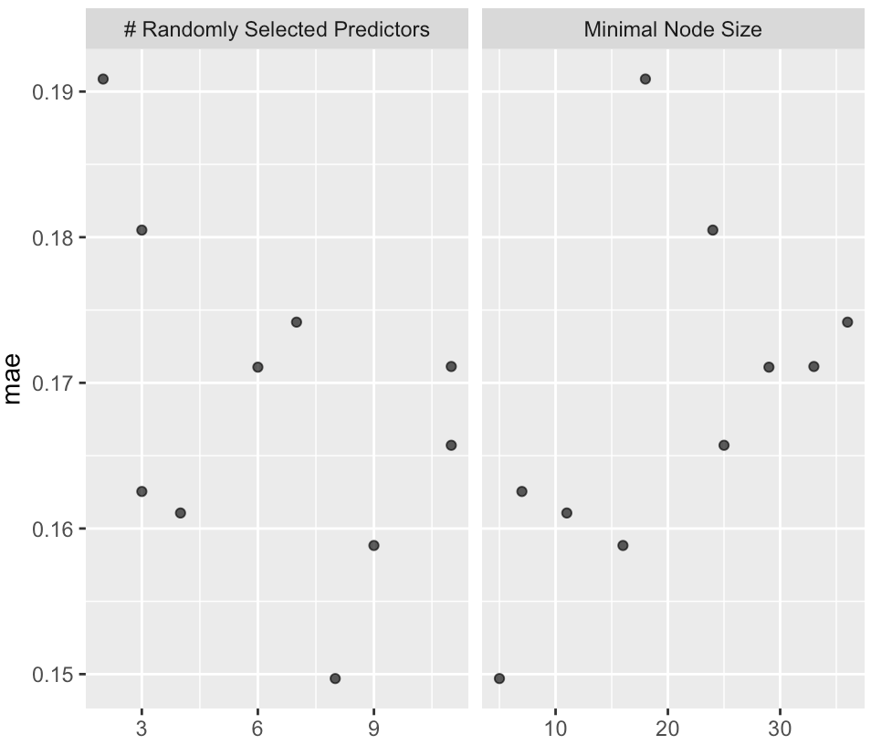
Data Collection
Data Preparation and Wrangling
Data Exploration
Model Training
Result
Data Cleansing
Data Preprocessing
Exploratory Data Analysis
Feature Selection
Feature Engineering
Method Selection
Performance Evaluation
Tuning
Random forest
Creating bootstrapped dataset
Creating decision trees from bootstrapped dataset
Typically, 1/3 of the original data does not end up in the bootstrapped dataset, called out-of-bag dataset
used out-of-bag to evaluate the accuracy of random forest
Original dataset
Bootstrapped dataset
Beds | Bath | Building Size | Price
2 | 1 | 890 | 800k
3 | 2 | 1600 | 1.2m
1 | 1 | 700 | 600k
3 | 3 | 2500 | 2m
Beds | Bath | Building Size | Price
3 | 2 | 1600 | 1.2m
1 | 1 | 700 | 600k
1 | 1 | 700 | 600k
3 | 2 | 1600 | 1.2m
Notes:
Same size as original
We are allowed to pick the same sample more than once

Slide 14
Thank you
Ali Tahsili

